Slide 1


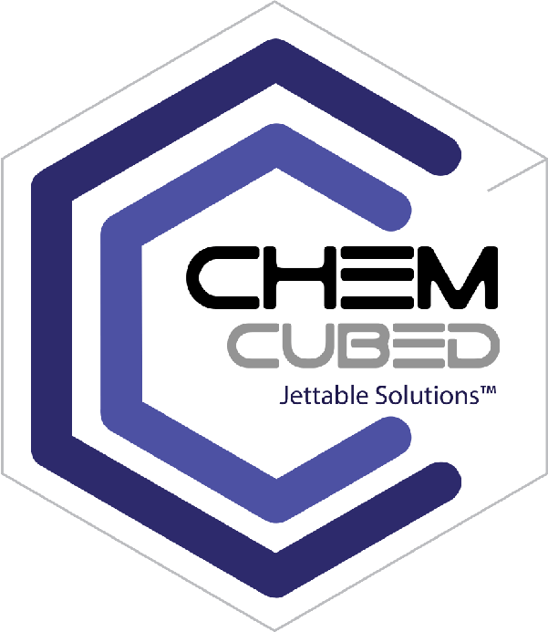
THE NEXT
BIG WAVE
Multi-Layer
Multi-Material
Digital Printing Solutions for
Tomorrow’s Electronics
Complete turnkey systems for next level additive manufacturing

Slide 2
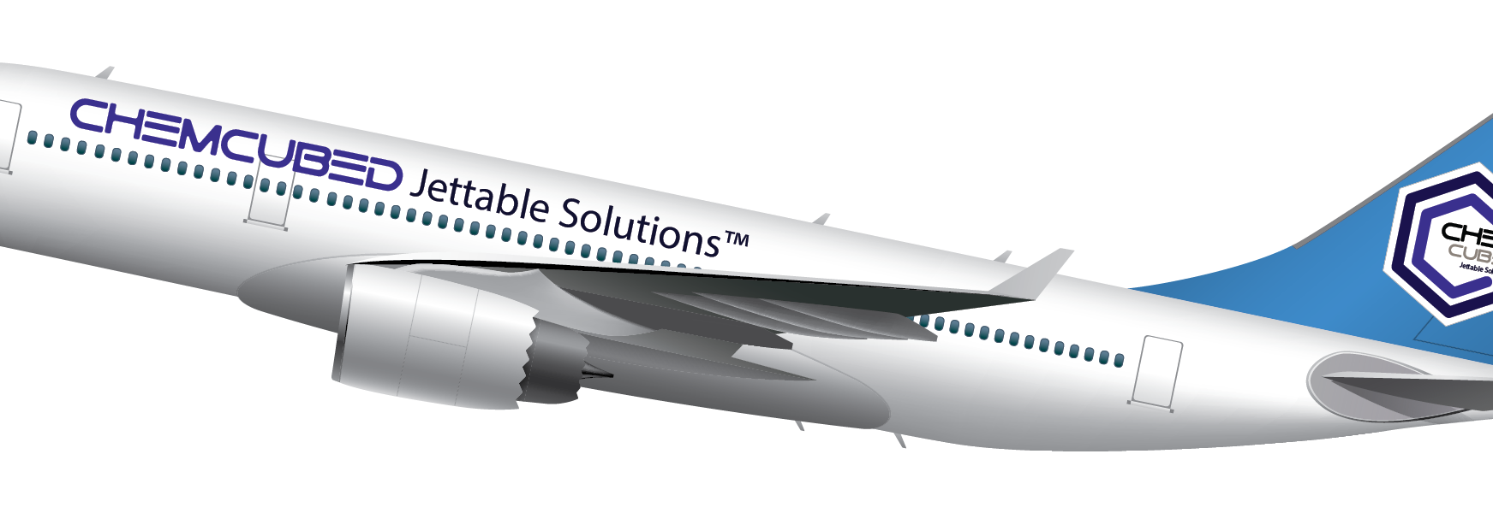
Who We Are
Research, development and manufacturing company of specialty materials for Additive Manufacturing (3D Printing)
Technical and business professionals with over 25 years experience in the printing industry
Focused on end-use applications for the material properties and the final product specifications

Slide 3

Key Market Segments
Advanced Manufacturing
Aerospace
Automotive
Electronics
Medical/Dental
Military/Defense
Optics
Security

Slide 4

Engineered for Performance
ChemCubed Brand Solutions
Multi-layer, Multi Material digital print solutions for Electronics
Nanoparticle-free silver conductive inks and dielectrics
UV 3Dprinting technology
Nanocomposite photopolymers for exponential performance
Rigid and flexible materials
Optical materials
ChemCubed ~833.243.6333 ~ info@chemcubed.com

Slide 5
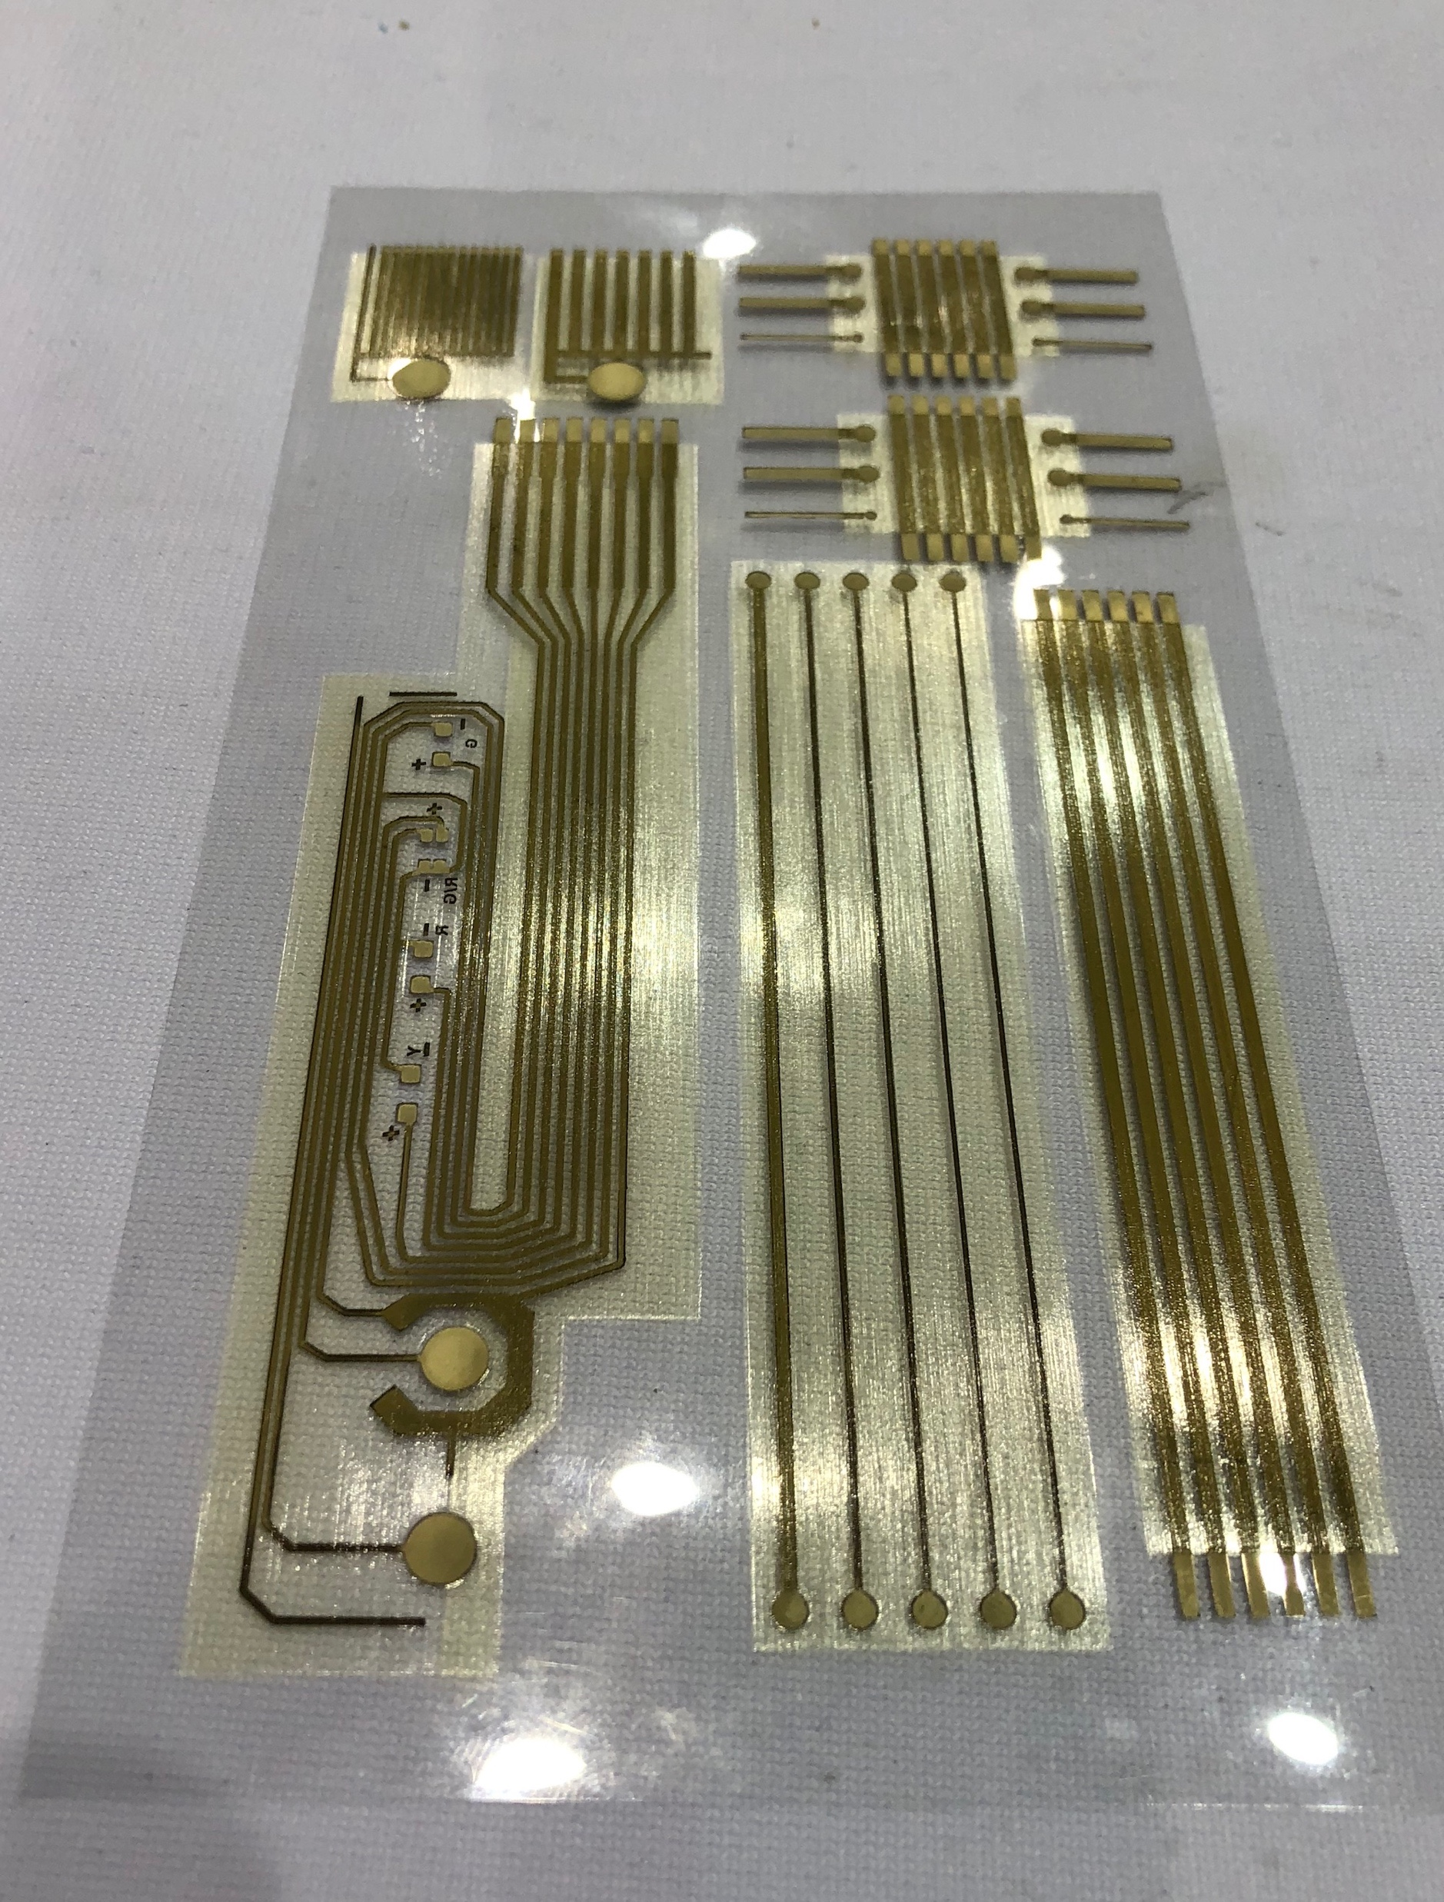
Printed Electronics Defined
Printed electronics is an all-encompassing term for the printing method used to create electronic devices by printing on a variety of substrates
Originally related to organic or plastic electronics that use inks made of carbon-based compounds
Demand for wearable devices, thinner electronics, higher performing applications are driving material and printer developments
Evolving over time toward print technologies capable of speed and cost efficiencies
Printed materials are becoming thin, light and flexible enough to be integrated into existing production lines

Slide 6
Printed Electronics Methods
Multiple Methods of deposition technology but not all are equal
Silk Screen
Syringe
Aerosol Jet
Direct metal / other emerging tech
Many considerations when reviewing deposition technology for an application
Digital printing
(variable vs. fixed)
Multi-material / Multi-layer requirements
Specialty vs. Commodity output (resolution, speed, size dimension)
Planar vs. 3-axis / 5-axis
Compatible materials
(Inks)
Inkjet
Direct Write
Thermal Transfer
Flexographic
Spray Coating
Spin Coating

Slide 7
Benefits of printed electronics
Sustainable Impact (additive vs. subtractive)
Fewer input materials
Less energy
Design, Development and Rapid Prototyping
Hours vs. weeks / Immediate design testing feedback
Speed of modification / Speed to market
In-house vs. outsourcing potential (IP security)
Custom fabrication / retrofits
Mitigate fleet electronics obsolescence
Reduced technical constraints typically associated with mass producing electronics
Component miniaturization / weight reduction
Functional optimization - multi-layering / embedding / protective encapsulation

Slide 8
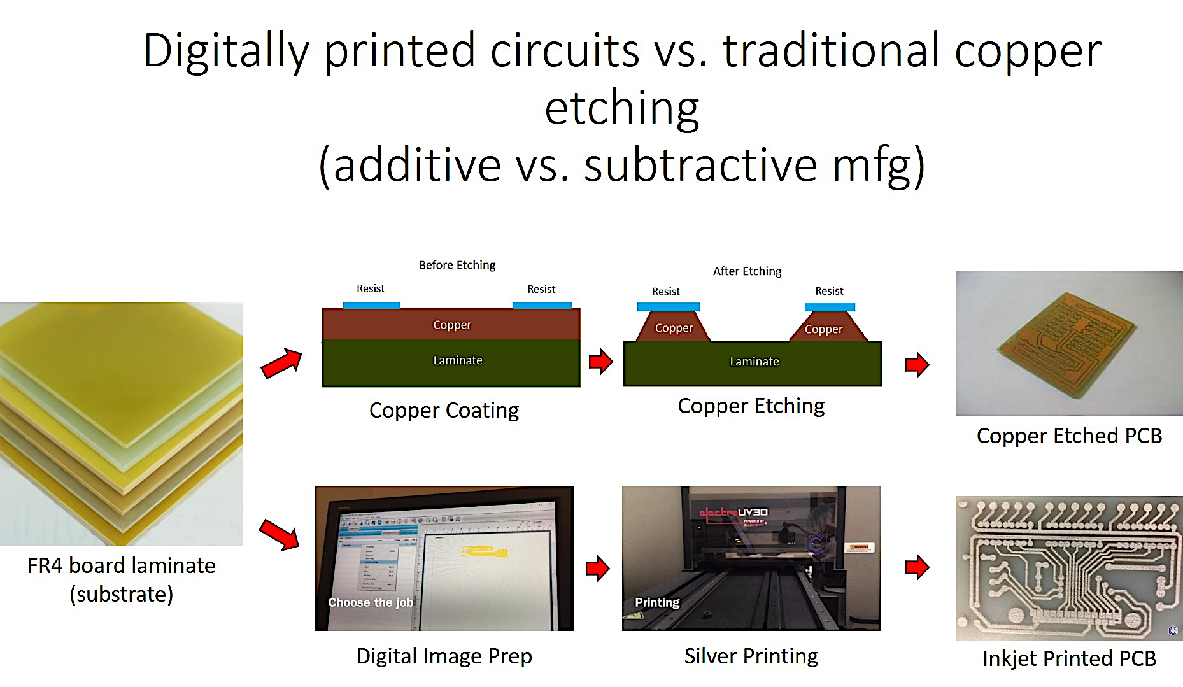
Additive vs. Subtractive
Traditional etch process
Mask resist to determine copper trace
Etch away unmasked copper
Fixed subtractive process
Changes require new mask/etch
Digital print process
Computerized image for copper trace
Print directly on substrate
Variable additive process
Changes by file and reprint
Multi-layer process
Traditional by repeat etch, lamination, drilling
Inkjet by sequence of file print / materials

Slide 9
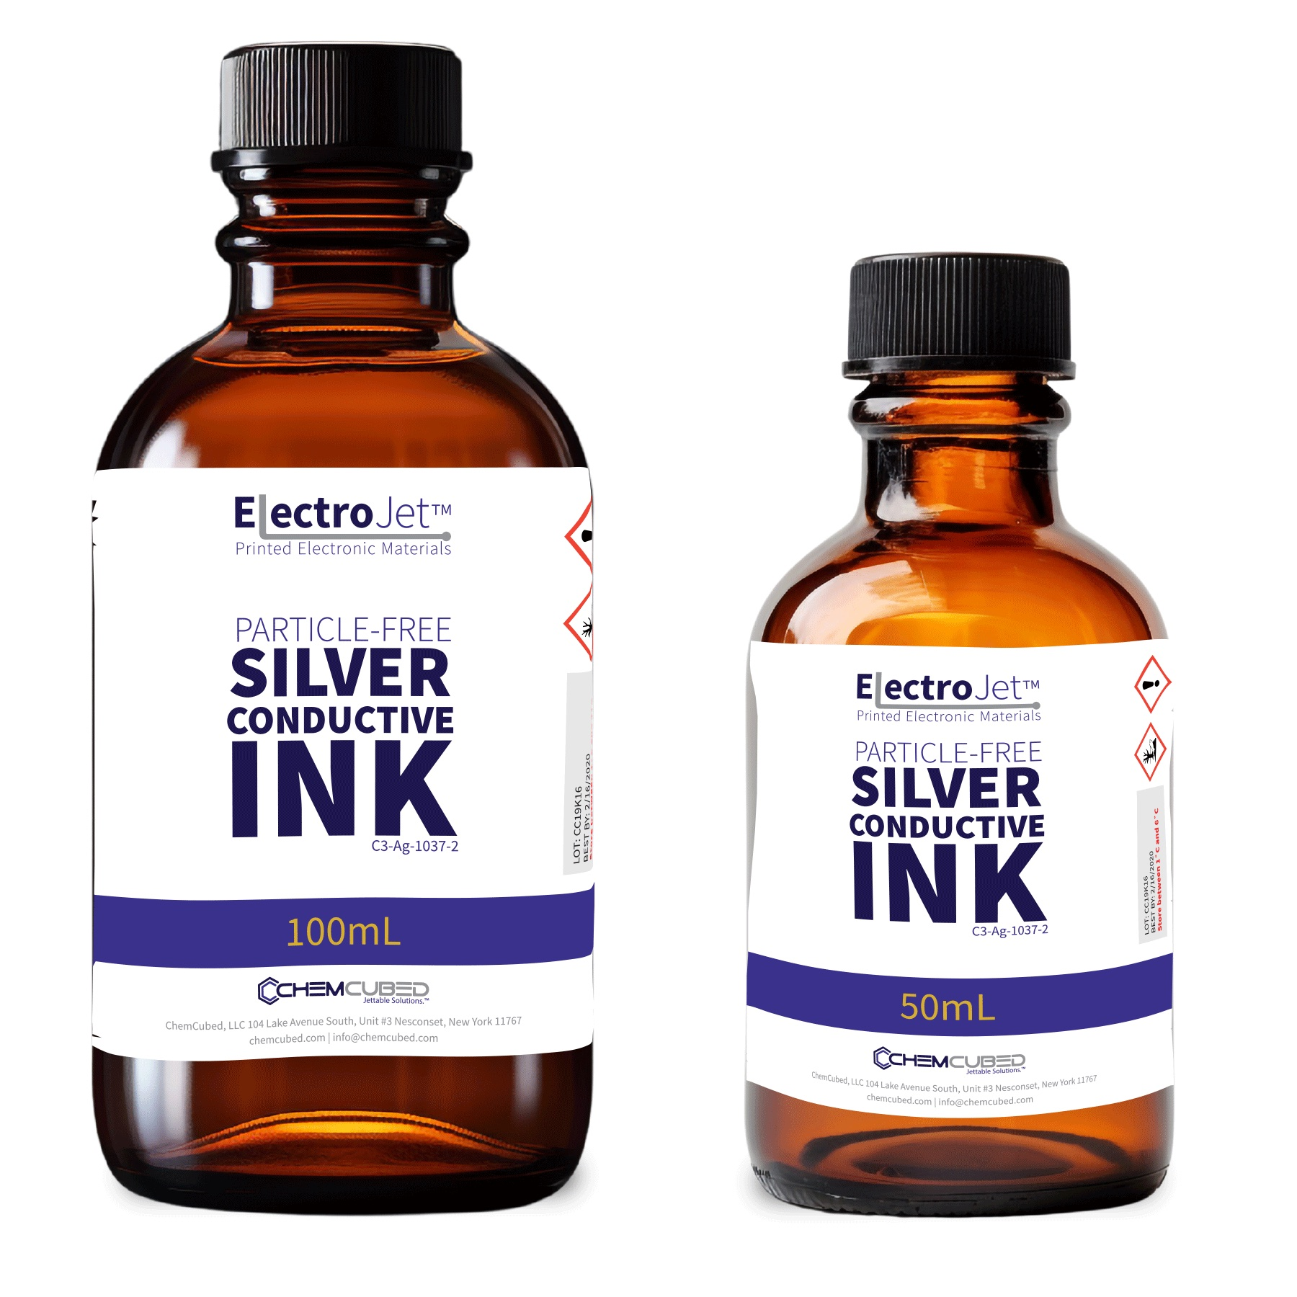
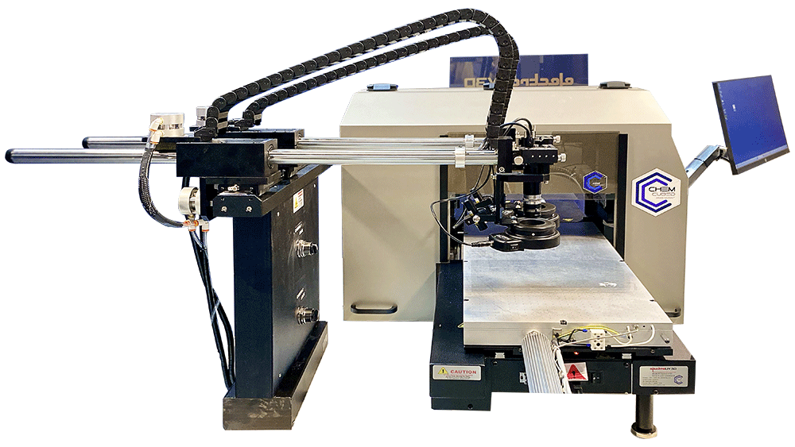
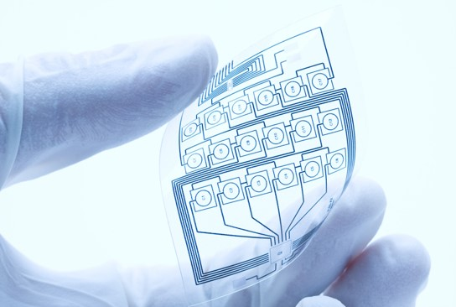
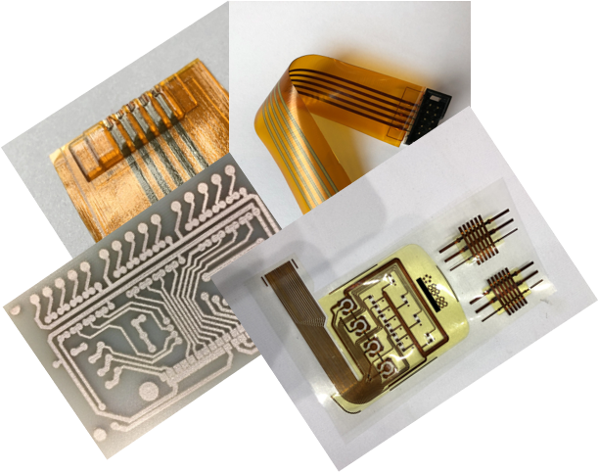
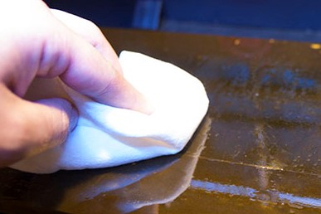
The System
The ElectroJetTM brand is a culmination of high-performance materials, inkjet printing technology, and process capabilities
  Materials are commercially available for a wide variety of applications
  Our eight-channel printers provide multi-layer, multi-material electronics with unparalleled performance
  Our process support gets your team trained within hours; our dielectric templating supports printing accuracy < 10 microns.
The trio provide a full synergistic solution for our end-user

Slide 10
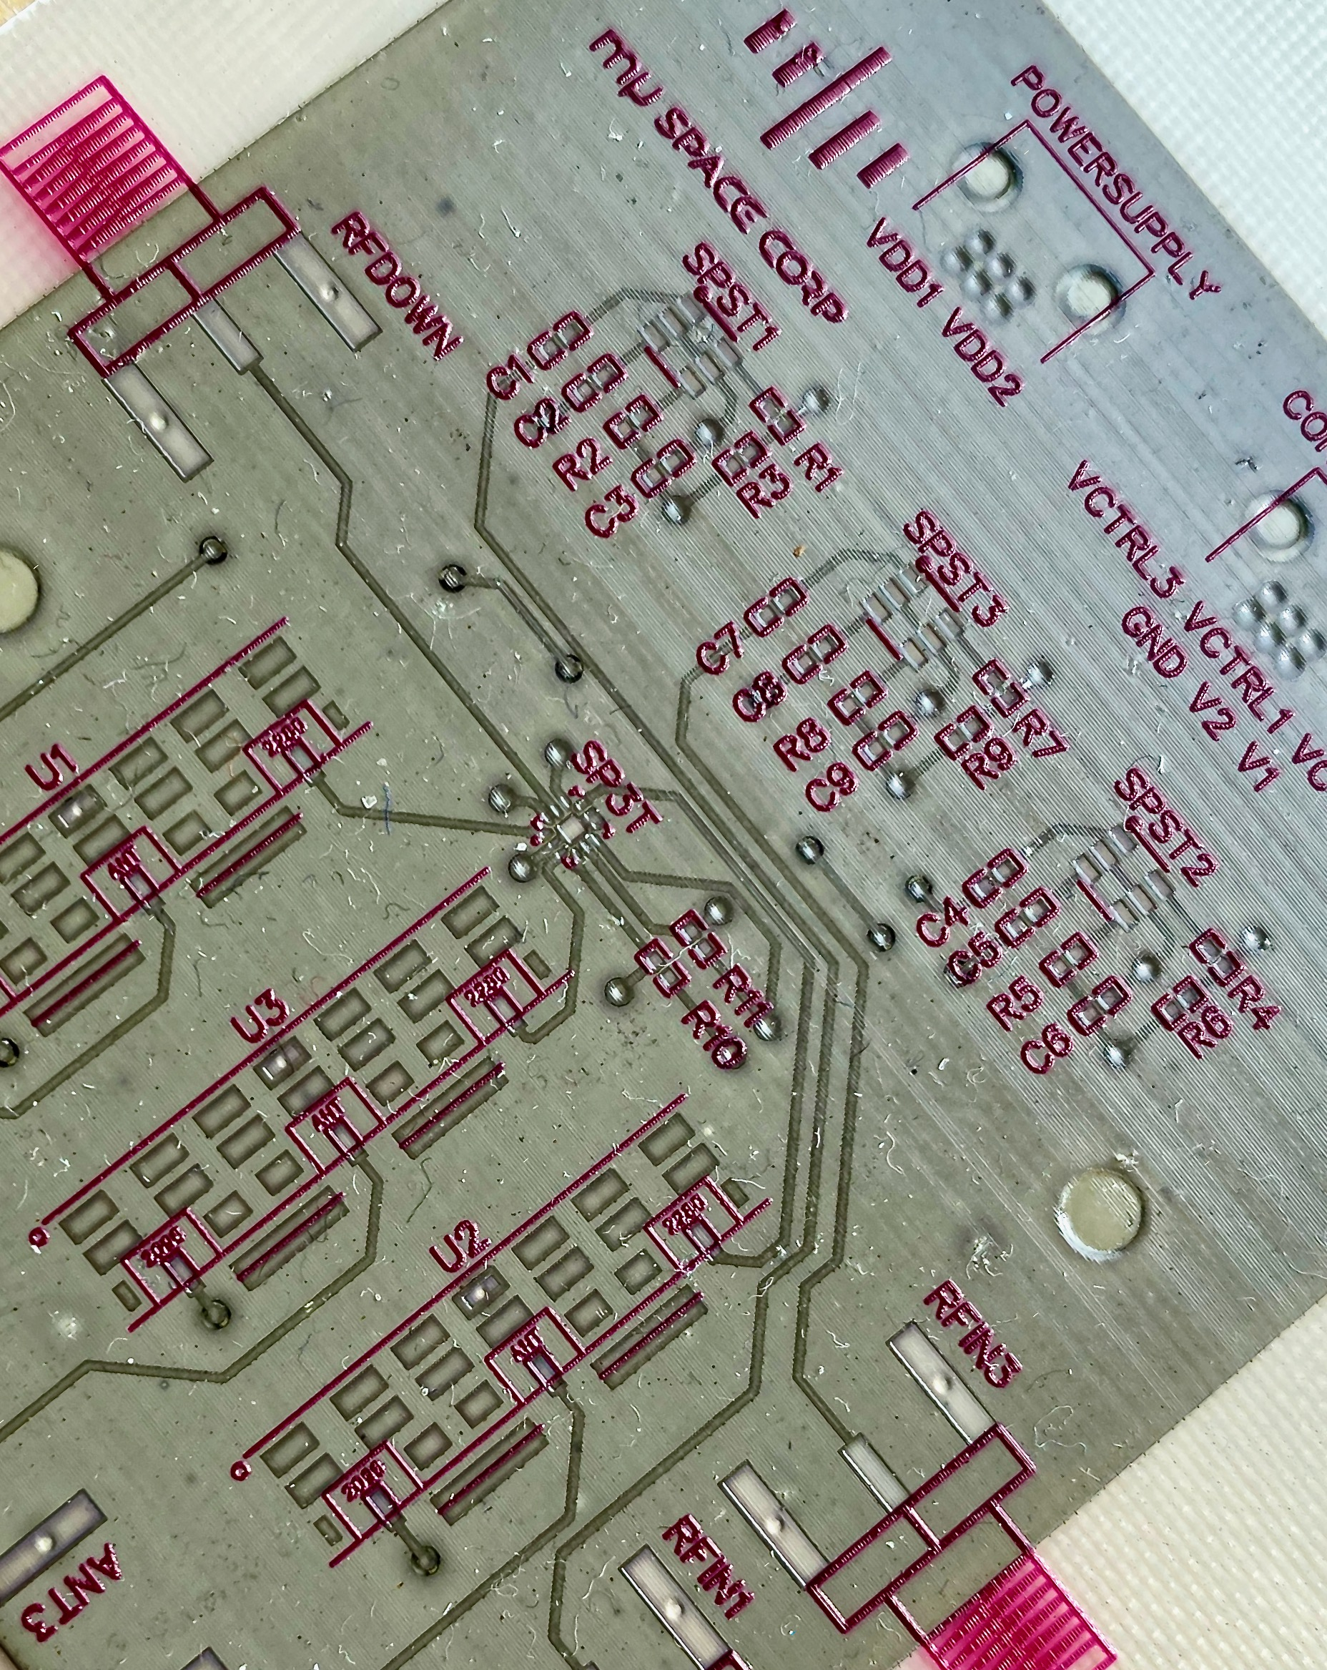
ElectroJetTM Materials
It is more about the ink than you think
Nanoparticle-free Silver
CONDUCTIVE Ink
Best-in-Class Conductive Performance
  near bulk conductivity of silver
  bulk resistivity in the range of 10⁻⁸ ohm-m
Unmatched Sintering Efficiency
  as low 80°C in 5 minutes
  as fast as seconds >100 °C
Superior printability and reliability with repeatability to within 1%
Excellent Adhesion to multiple substrates
UV Curable
DIELECTRIC Insulating Ink
Superior Insulating performance between conductive layers
Adhesion promoter to high surface energy substrates
Encapsulation to protect from moisture, chemicals and physical abrasion of the external environment
Multiple formulations optimized to end-use applications
C3-Ag-1037-2: Standard for electroUV3D printer
C3-Ag-1037-2h: Viscosity tuned for brand inkjet heads
C3-DI-7: Standard workhorse formula
C3-OPT-7: Optically clear high-pot insulating
C3-DI-8: Optically clear flexible layers
ChemCubed 833.243.6333
info@chemcubed.com

Slide 11
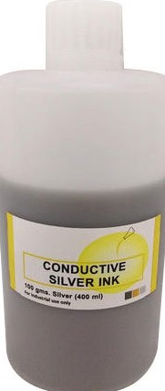
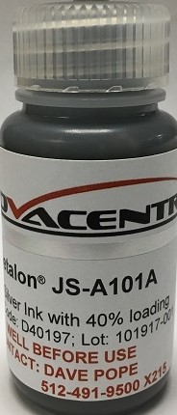
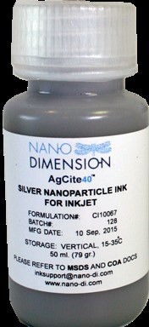
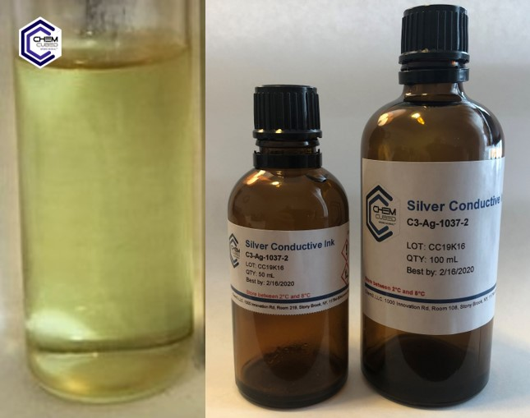
ElectroJetTM Materials
The difference is clear
Nano-particle Silver Inks
ElectroJetTM Particle-Free Silver Ink
Brand X
Brand Y
Brand Z
  Opaque in color
  15 - 40% silver particle loading
  Contains other fillers/resins
  Particles settle and require recirculation prior/during use
  Transparent in color
  Particle-free
  Contains NO fillers or resins
  Simply filter prior to use and ink remains stable without recirculation
ChemCubed ~833.243.6333 ~ info@chemcubed.com

Slide 12
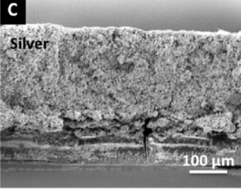
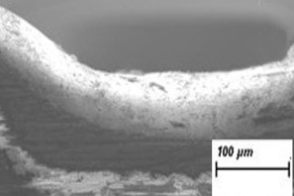
ElectroJetTM Materials
Clearly, there is a difference
  Particles can clog inkjet heads
  Sintering temp 130c / 30 min
  Sintered silver and fillers
  (40 – 60%)
  Filler and/or voids are non-conductive
  Jettable reliability
  Sintering temp 80c / 5 min
  Sintered silver only (99%)
  Void-free silver is fully conductive
ChemCubed ~833.243.6333 ~ info@chemcubed.com

Slide 13
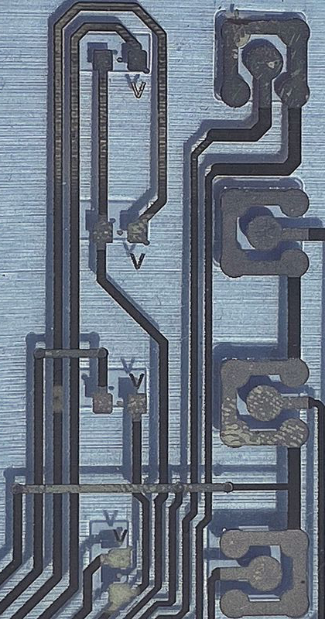
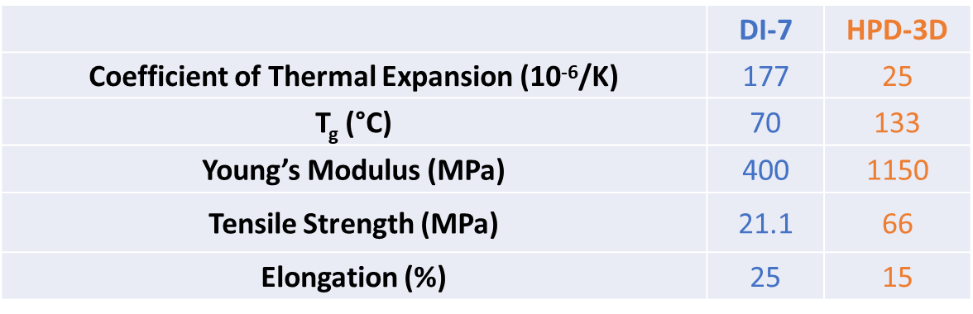
High Performance Dielectric – our newest ink
Our most recent formulation is a revolutionary nanocomposite dielectric material that:
insulates layers between the circuits,
masks material for soldering, and
supports at connection points; thereby allowing it to replace F board for two-sided boards
ChemCubed ~833.243.6333 ~ info@chemcubed.com

Slide 14
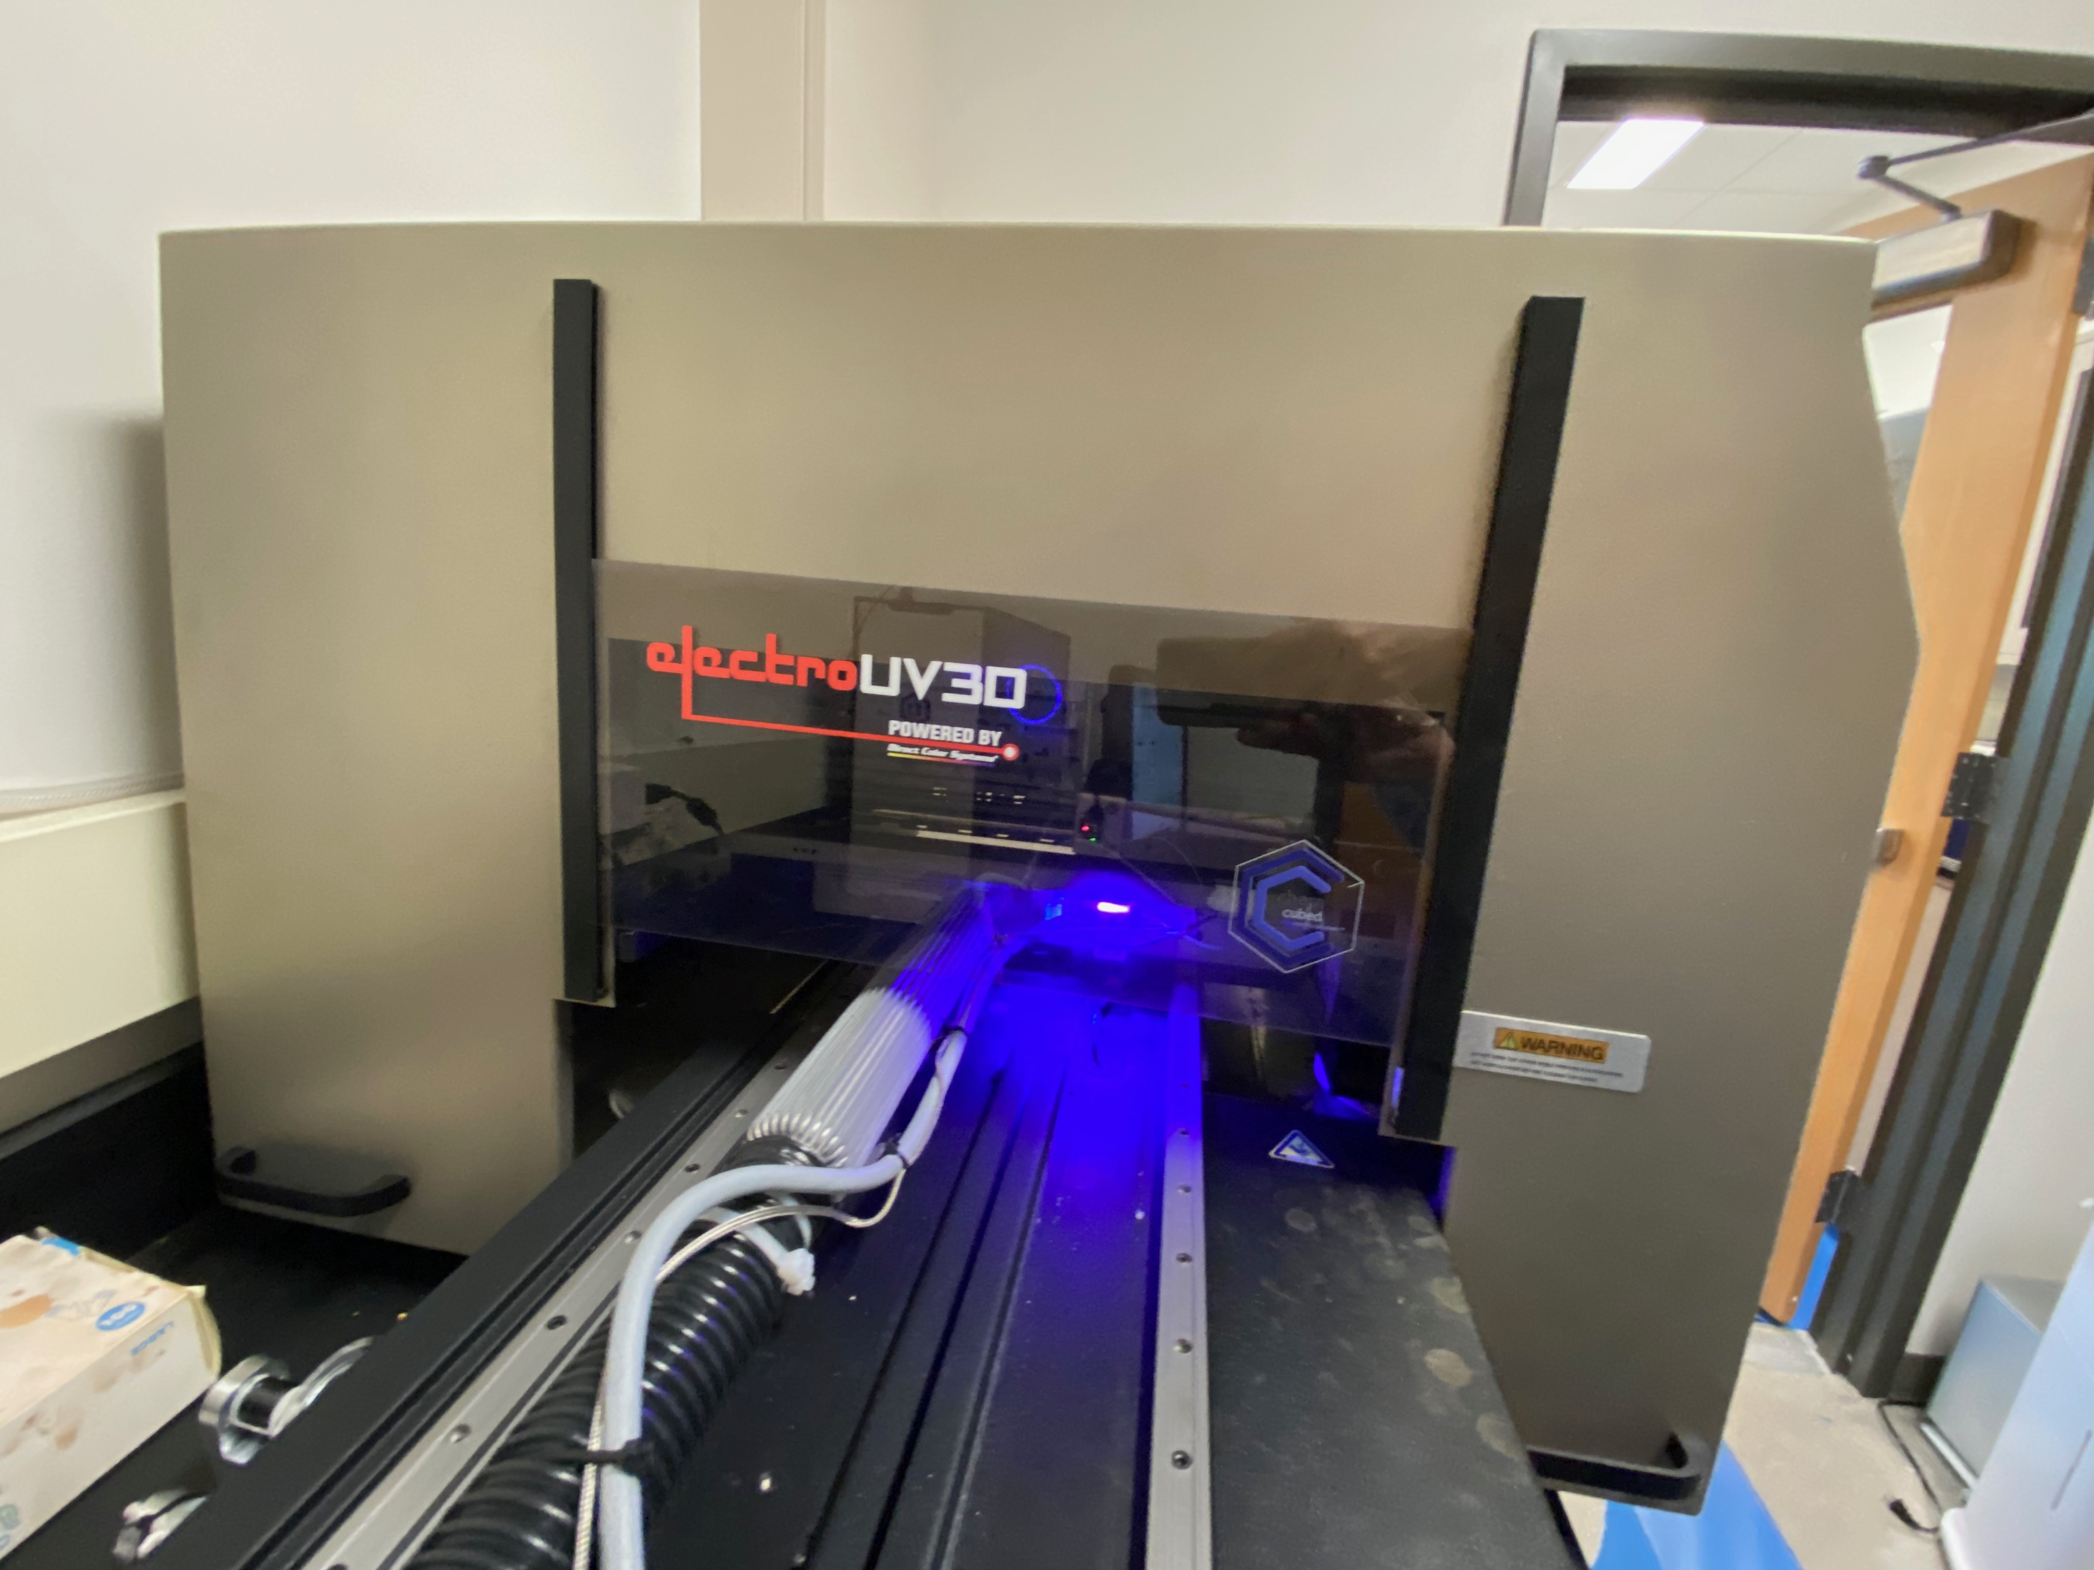
Printing Technology
There is not only a need for higher performing materials,
but also, the combined solution of a ready-to-use and fully capable printing technology
Needs of a Commercial Printing Tool Solution:
Inkjet process to replace multiple steps and hands-on techniques
Unprecedented low cost and efficient production
Flexibility to design/develop/prototype and finally PRODUCE for the majority of digitally printed electronic applications
Multi-material layering of functional coatings and laminations
ChemCubed ~833.243.6333 ~ info@chemcubed.com

Slide 15
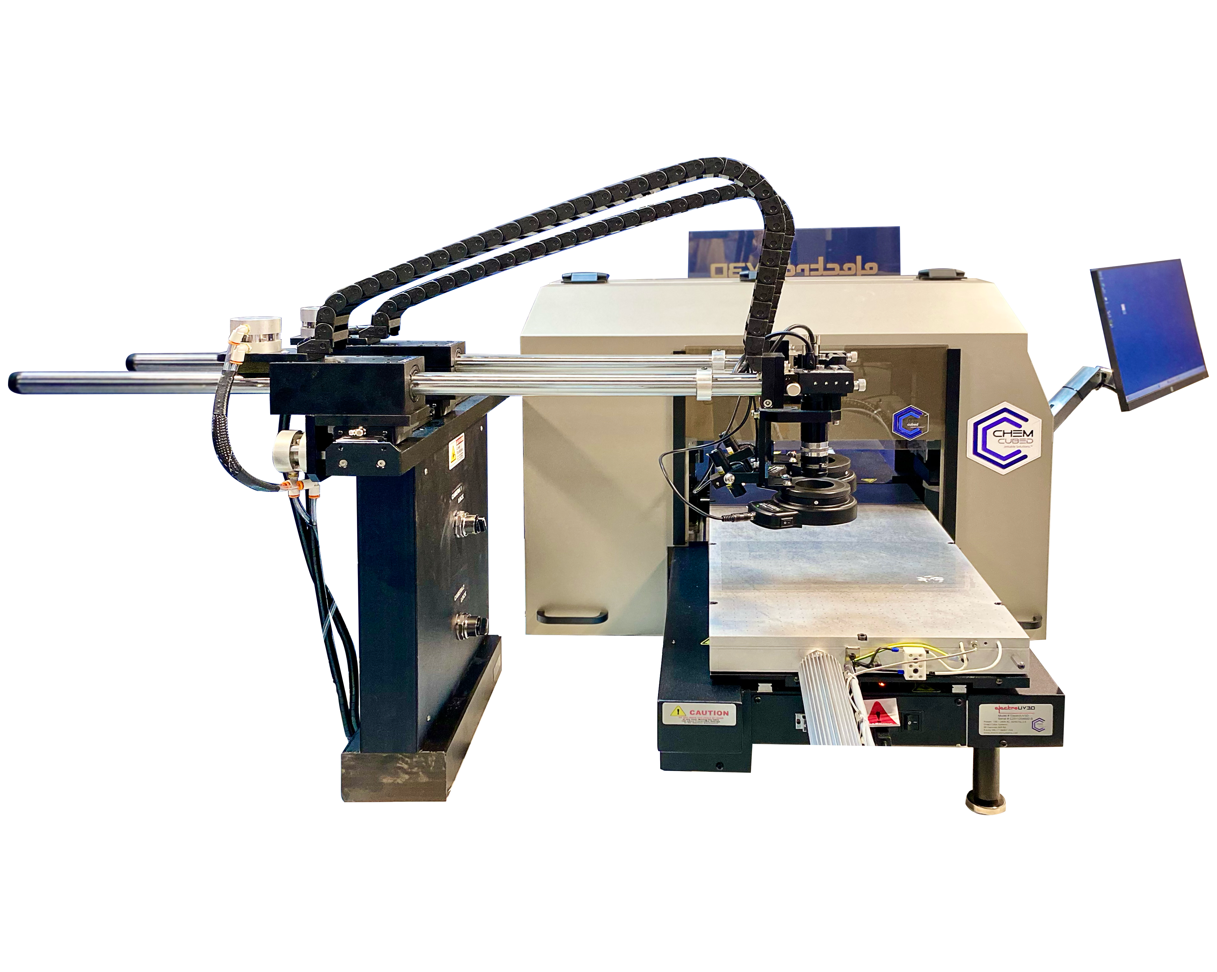
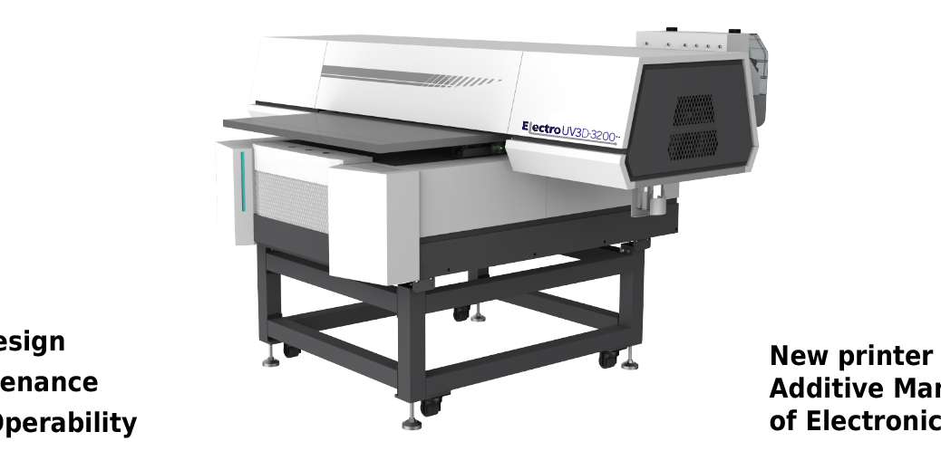
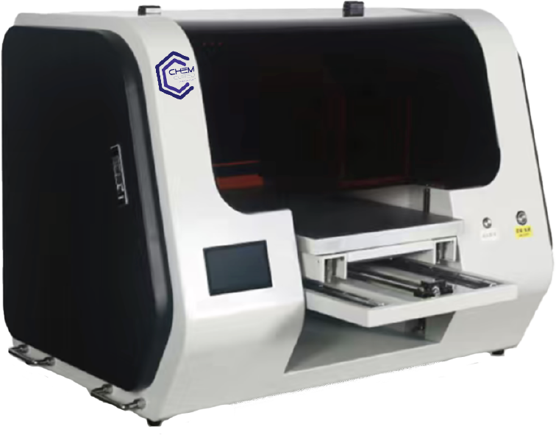
The Original
ElectroUV3D Printer
ElectroUV3D-3200
ElectroUV3D-1218

Slide 16

High Speed, High Performance

Slide 17
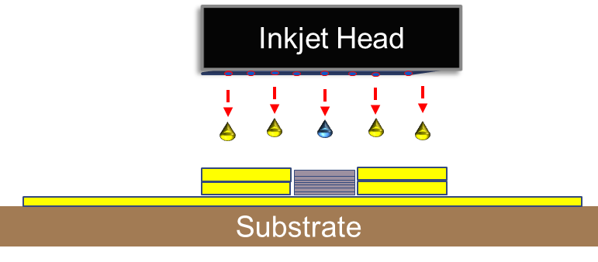
Dielectric Templating
Controlled Trace Widths
Increased Trace Heights
Optimized Conductivity

Slide 18
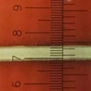
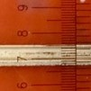
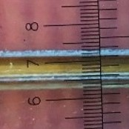
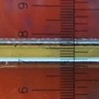
Silver trace layering effect
Without dielectric templating:
Fig1A – 3 passes of silver ink
Fig1B – 18 passes of silver ink
Trace height fails to build in z-direction effectively (~max 5 um)
Trace width continues to spread (0.55mm to 0.80mm)
Fig 1A
Fig 1B
With dielectric templating:
Fig1C – 3 passes of silver ink
Fig1D – 18 passes of silver ink
Trace height builds effectively in z-direction (~24 um)
Trace width is maintained (0.40mm)
Fig 1C
Fig 1D

Slide 19
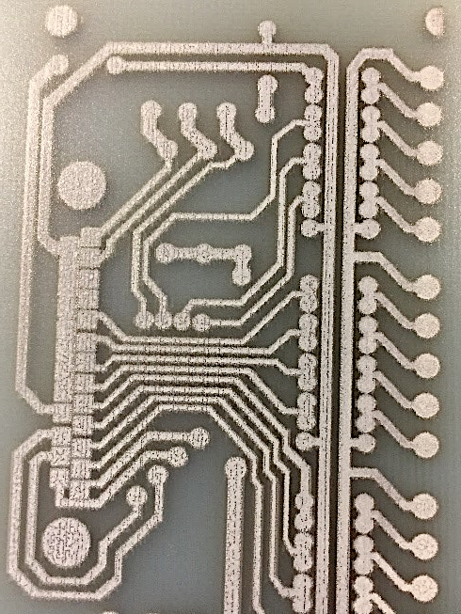
Post Print Process
Solder Mask Procedure
Protects a printed circuit against oxidations/prevents solder bridges between solder pads
Widely used in reflow soldering
Printed by ElectroUV3D printer, same process as dielectric ink

Slide 20
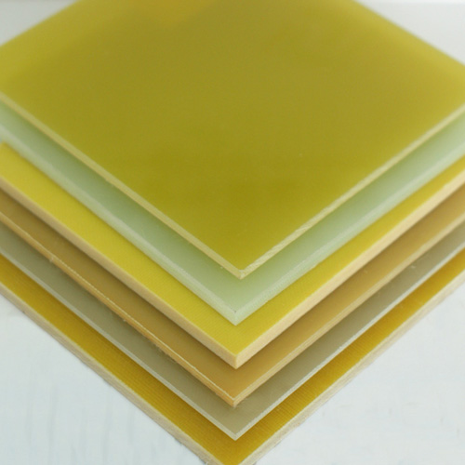
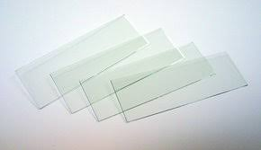
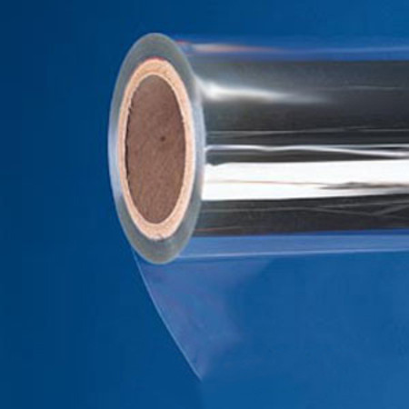
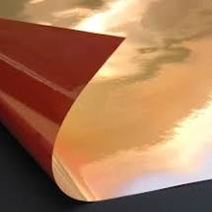
Substrates
Rigid, Flexible and Rigid/Flex* planar materials
FR4 board
Liquid Crystal Polymer (LCP)
Polyester (PET)
Polycarbonate
Polyimide Film (Kapton)
Glass
ITO coated glass
Ceramic
Foil / Metal
Paper / Coated Paper
Label stock
*Rigid material may be printed on flexible substrates
ChemCubed ~833.243.6333 ~ info@chemcubed.com

Slide 21
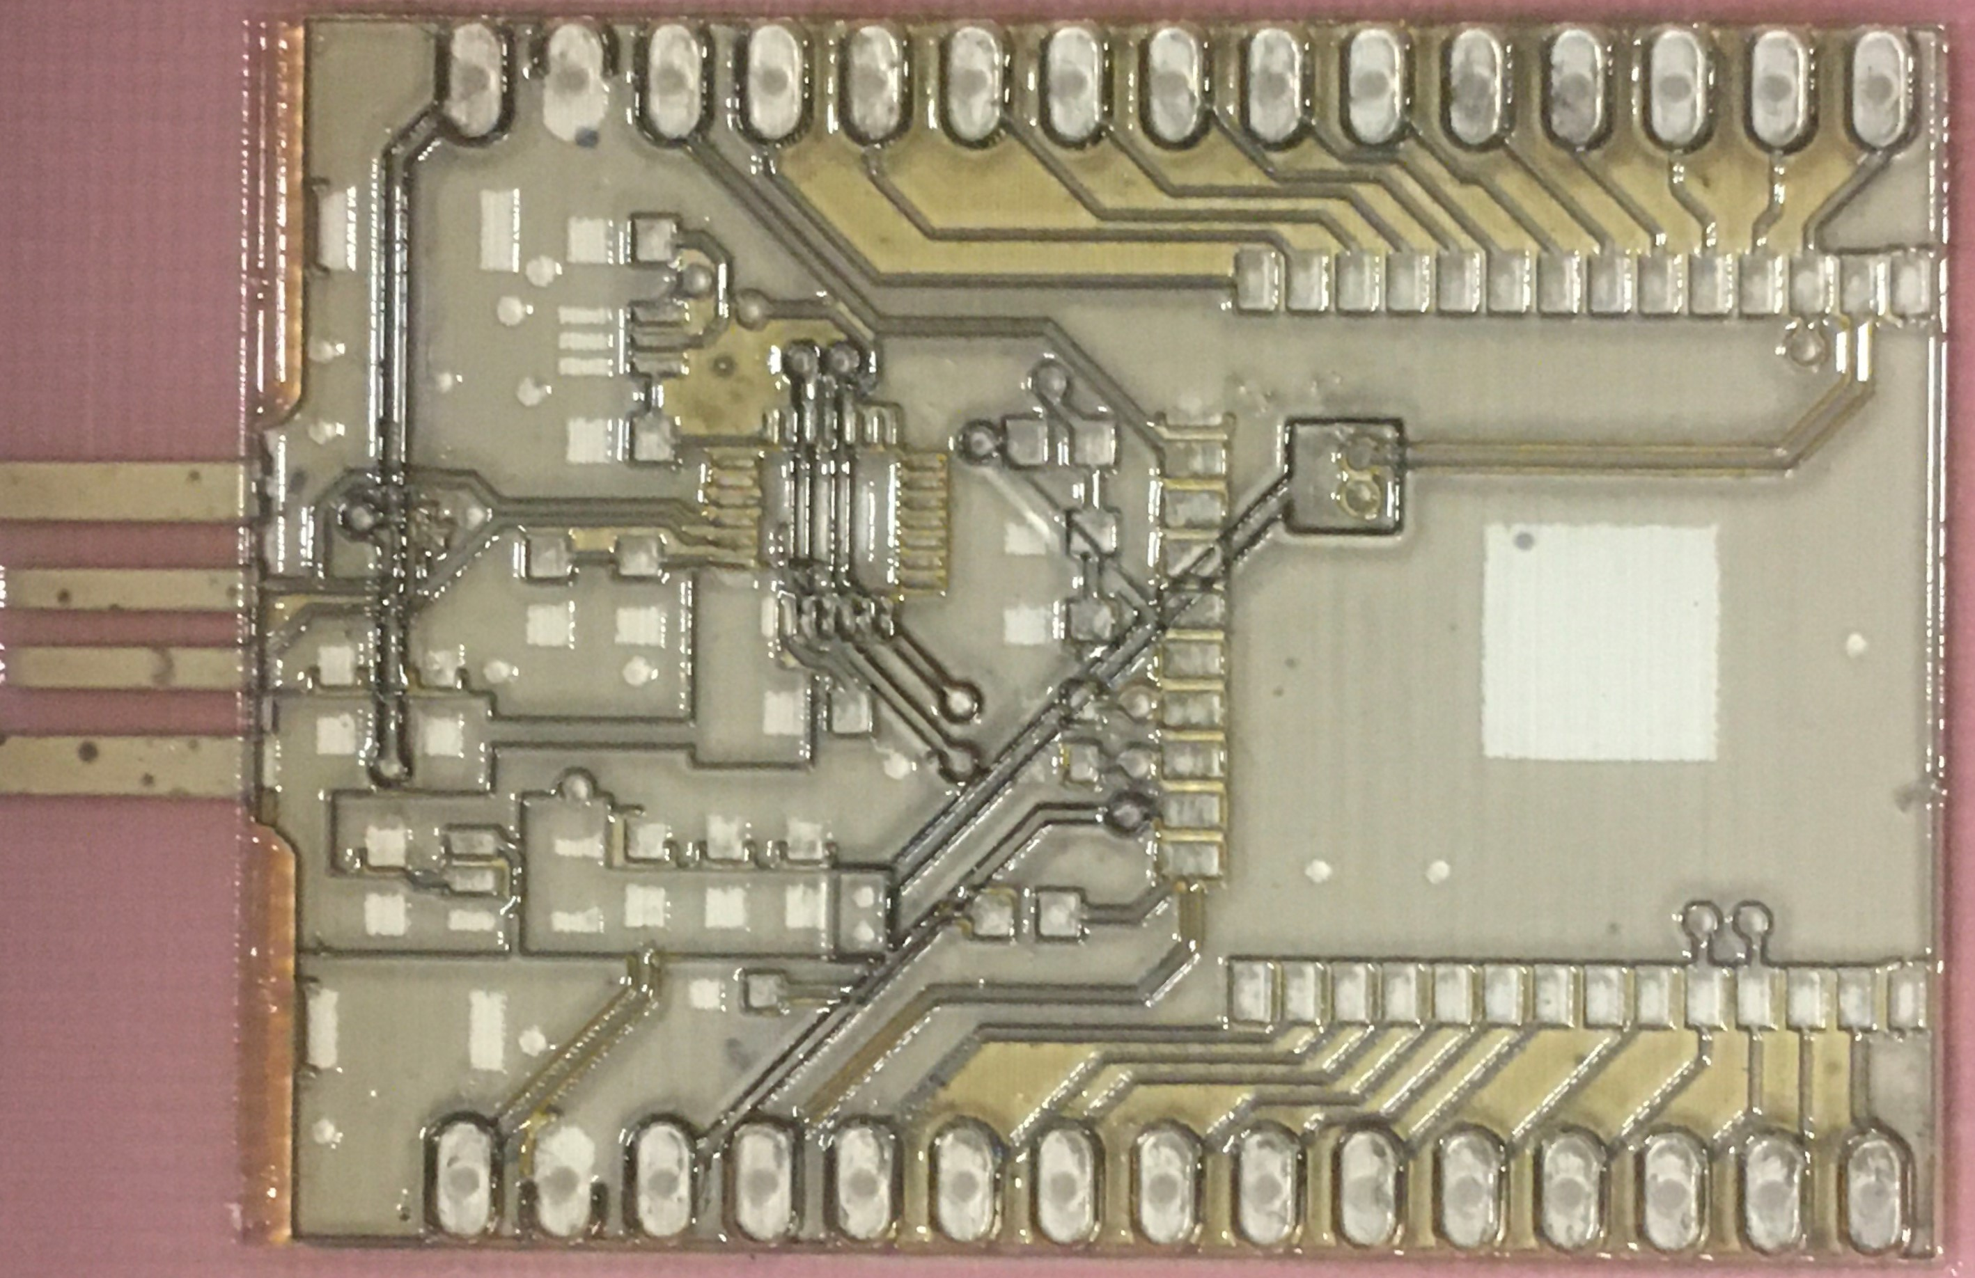
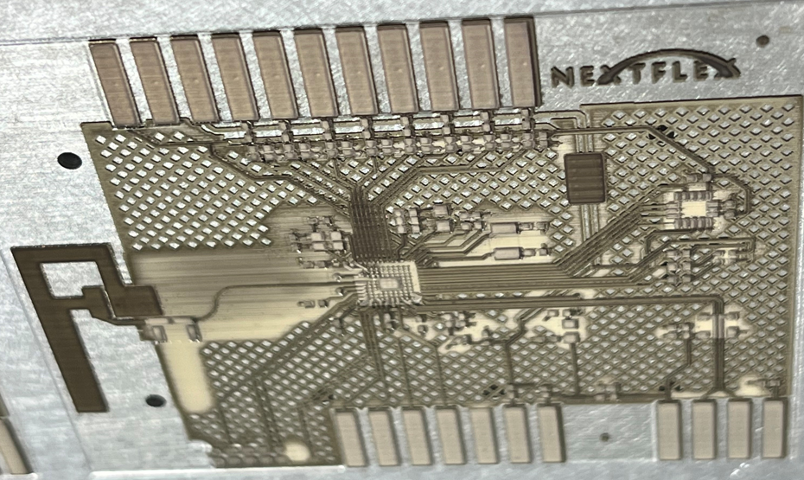
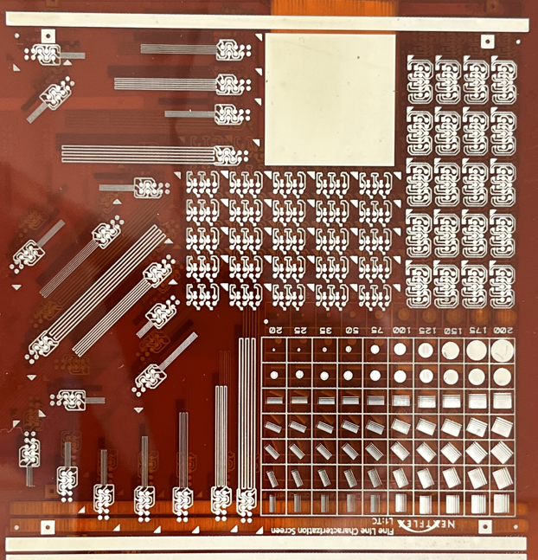
Multi-layer Processes
ChemCubed ~833.243.6333 ~ info@chemcubed.com

Slide 22
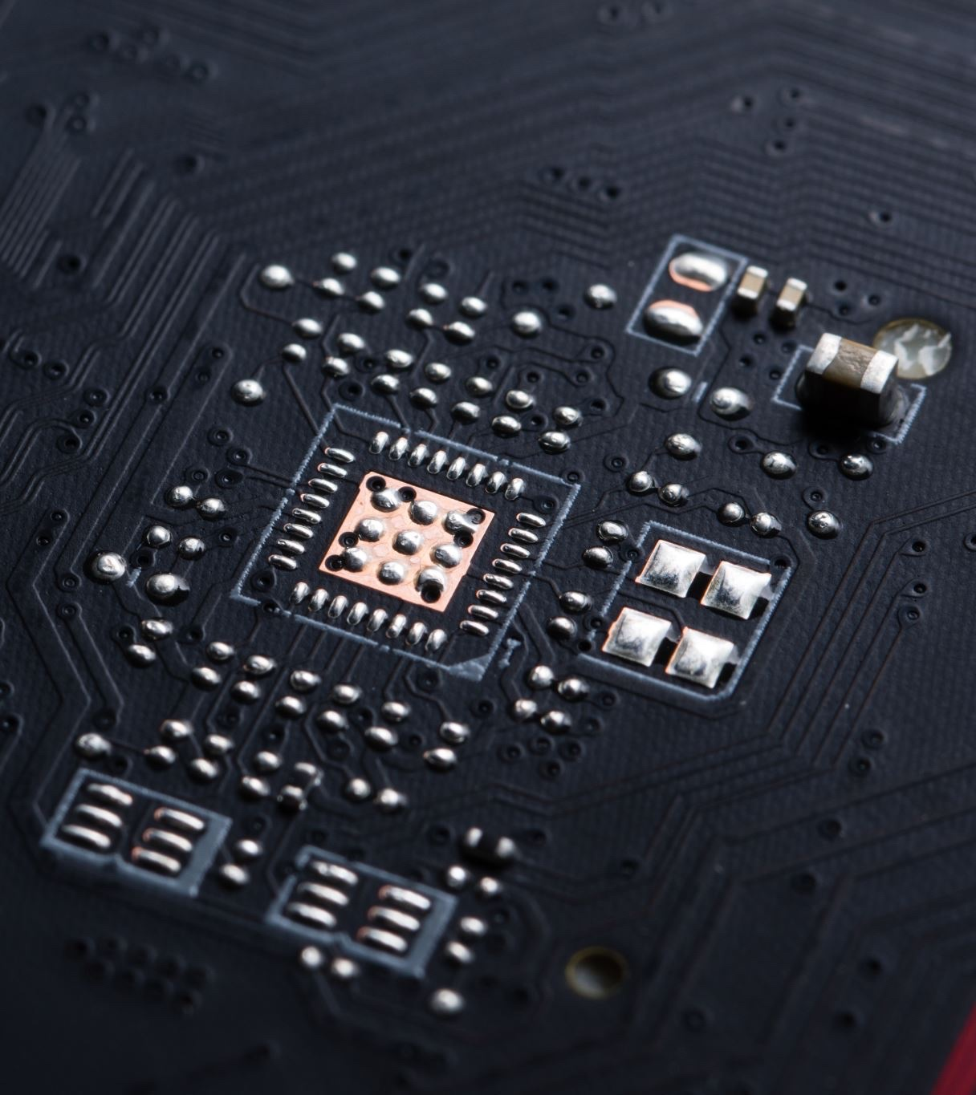
Applications
Printed circuitry/circuit boards/electronics packaging
Displays
Flexible hybrid electronics, writing harnesses
Passive components (resistors, capacitors, inductors)
RFID, sensors, shielding and antennae applications
Semiconductor manufacturing
Photovoltaics
Wearables

Slide 23
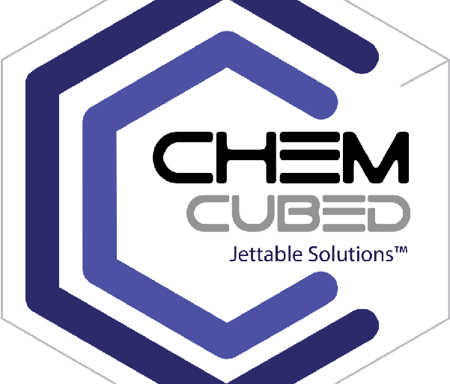
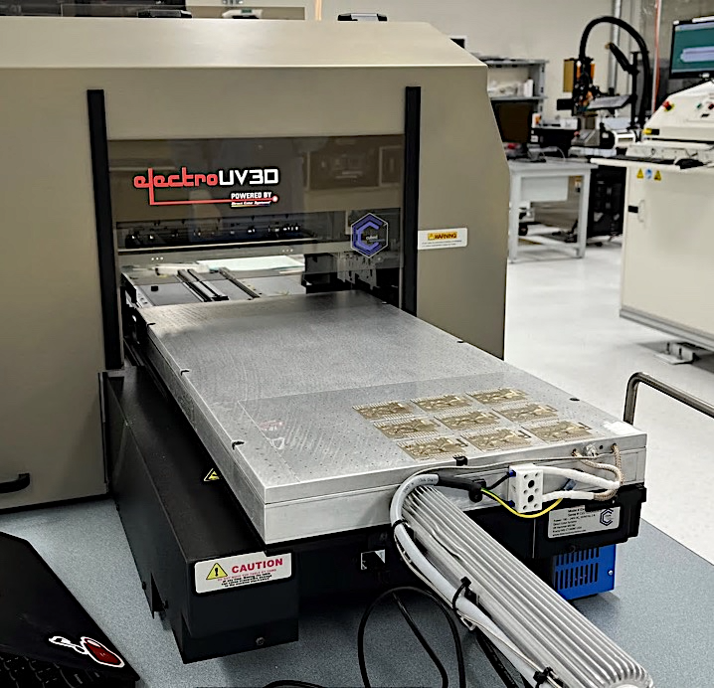
Contact us
ChemCubed Jettable Solutions™
+1 (833) 243-6333 (CHEM333)
www.chemcubed.com
info@chemcubed.com

